Slide 1
Logic of the 50/60s
Colorado State University
Computer Science Department
Slides Originally Created by Albert Lionelle (Albert.Lionelle@colostate.edu)

Slide 2
Poorly Defined Logic of the 50/60s
Industry was used to building products
Machines are products
But Code was not
For the first time, the value shifted from the product to the person
You are a company’s most valuable commodity!
Especially true with computer science
This created a dichotomy
In some cases, still exists today
Automatic Programming / Coding
At the heart of this!
If you can replace coders with machines..
Enter Cobol and Univac
Additional Reading: Techs Ultimate Success

Slide 3
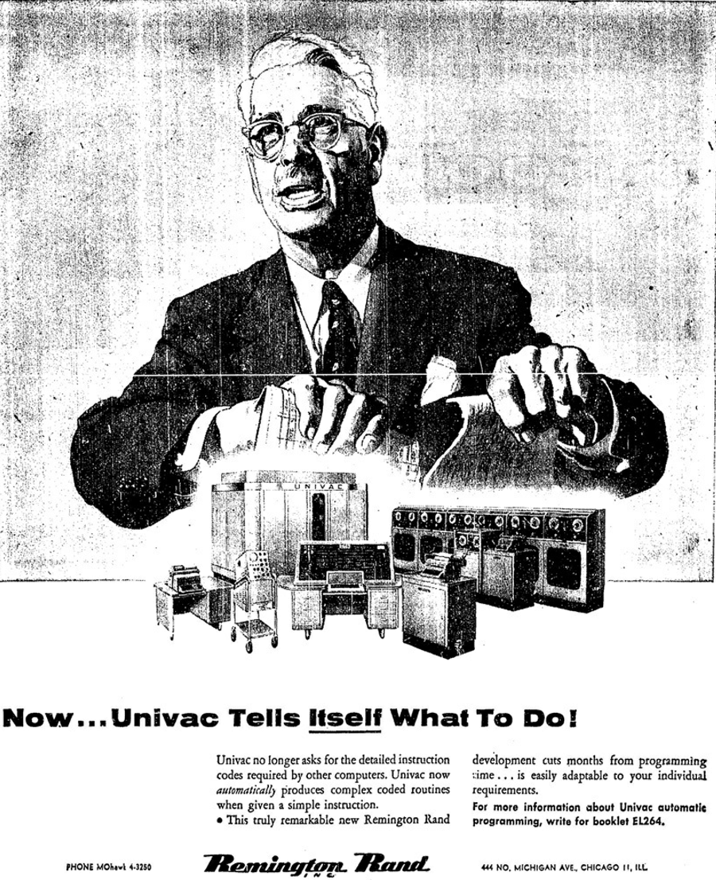
No more coders?
Actual ad. for the Univac after the creation of Cobol
Let’s think about it…
The industry didn’t know what to do with programmers
Some wanted to get rid of them
Others wanted to hire more
Truth
Everyone was tied to this new thing called a computer
Programmers were becoming even more important
Second law: Invention is the mother of necessity.

Slide 4
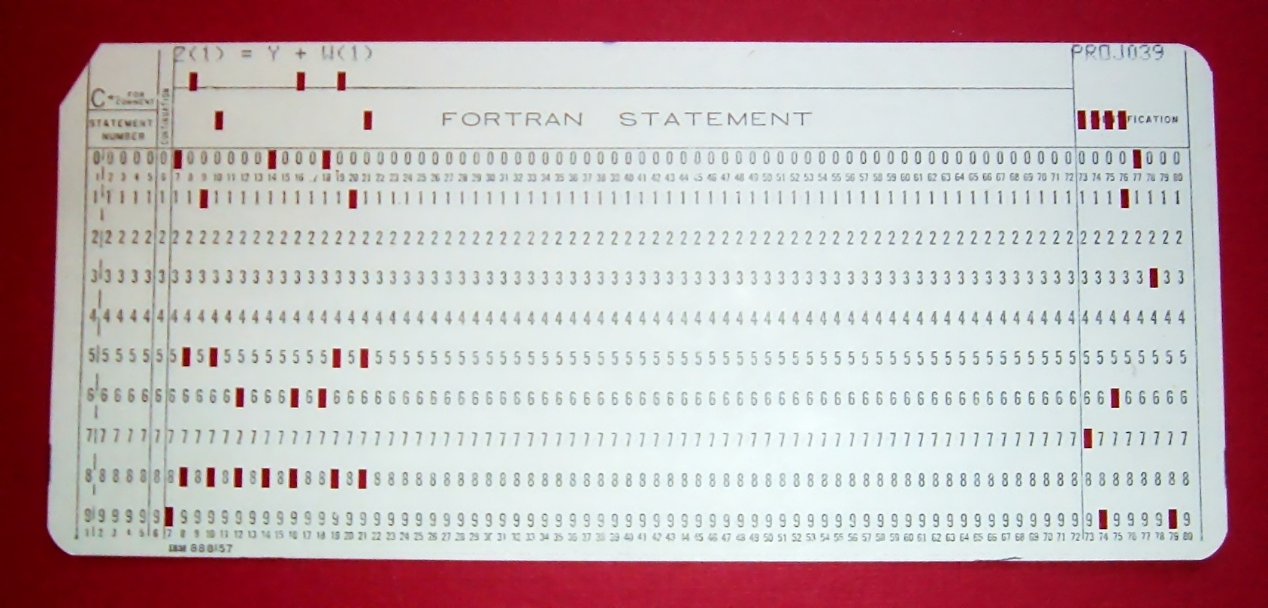
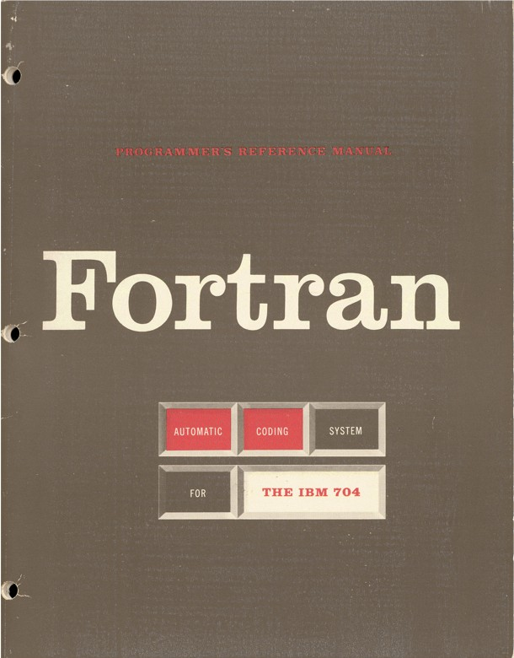
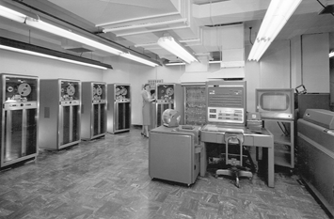
Fortran
Designed by John Backus
first optimizing compiler
Very important or wouldn’t work
1957 (10 years after WW II)
Punch Cards
Machine time limited
Designed programs on paper
Shared times
English -> punch cards -> machines
Designed for business use
Accounting
Math calculations
All text based
Hidden Figures <- Go watch it!

Slide 5
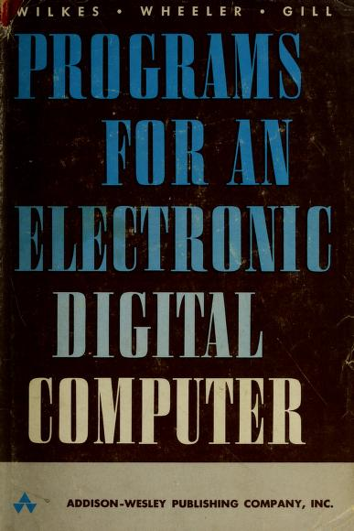
Secrets from the past?
Rare for a program to work right the first time
“The Preparation of Programs for an Electronic Digital Computer” (1951)
Considered the world's first programming book
Still true!
Imagine compilers:
Only generate code once a day
Even then, there would be bugs
Lone ranger mentality
Coming in fixing code, not sharing how it is done
This started to push women out of the industry
Would be specialized to certain fields
Wouldn’t usually get along with management
Management wanted to break free of their programmers

Slide 6
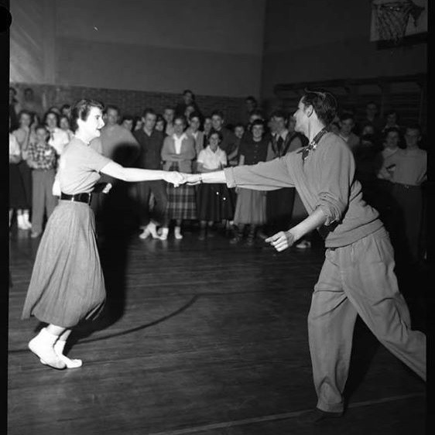
What does it take to be a good programmer - 1950s/60s edition?
IBM Programming Aptitude Test
number series
figure analogies
arithmetical reasoning
Cooking?
“Your Career in Computing” - 1968
If you can read a cookbook, you can be a programmer!
Worry about details while keeping big picture in mind
Books even said females could be better programmers
In truth
Wanted cheaper labor
Trying to fulfill a shortage - with women that others were pushing away
There has almost always been a shortage of programmers - we have one now.

